Slide 1
Predicting Housing Prices
Team Training Day:
Jose Gonzalez, John Sipala, Elliot Frost

Slide 2
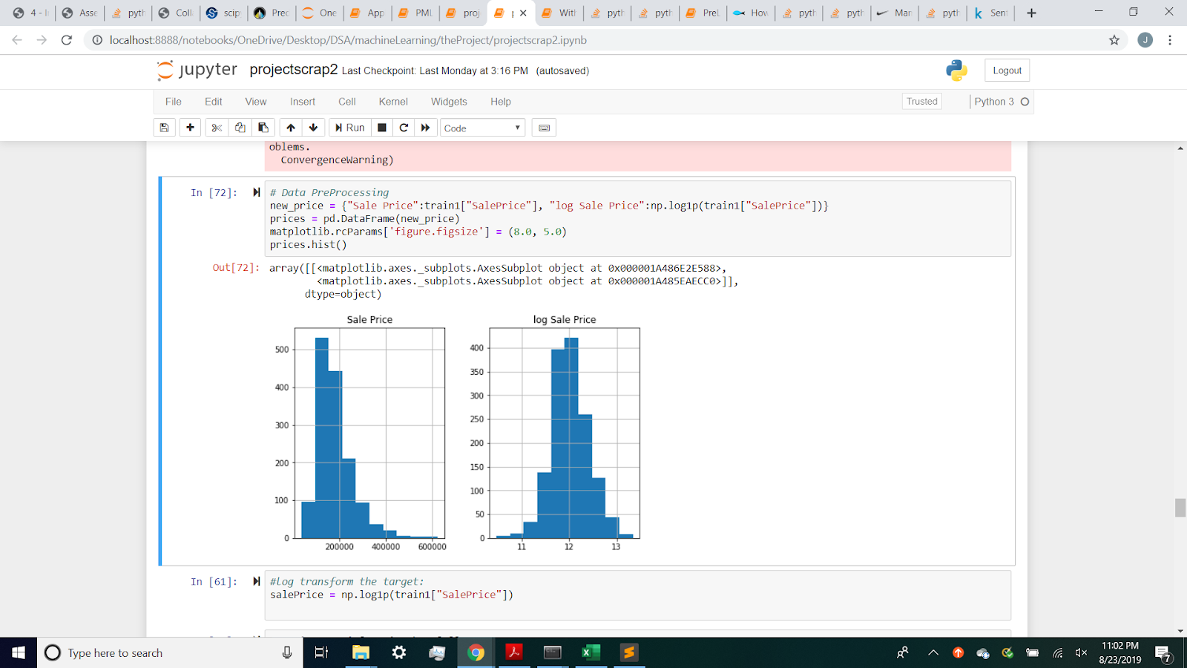
Sale Price and Log Sale Price

Slide 3
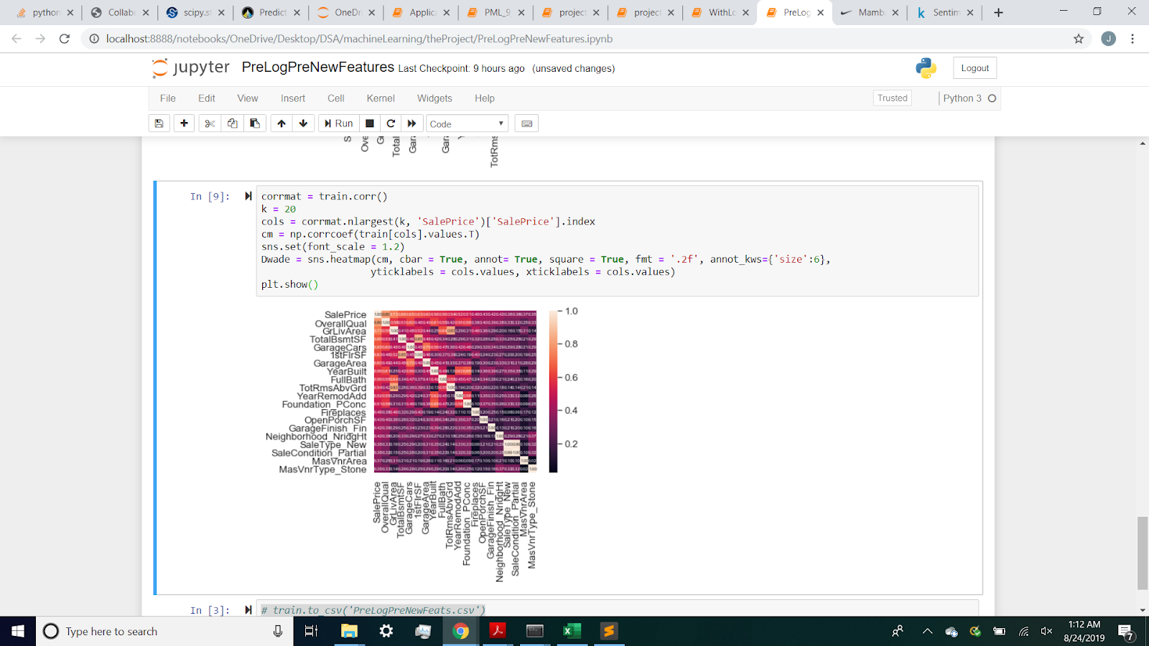
Top 20 Correlation Before New Features

Slide 4
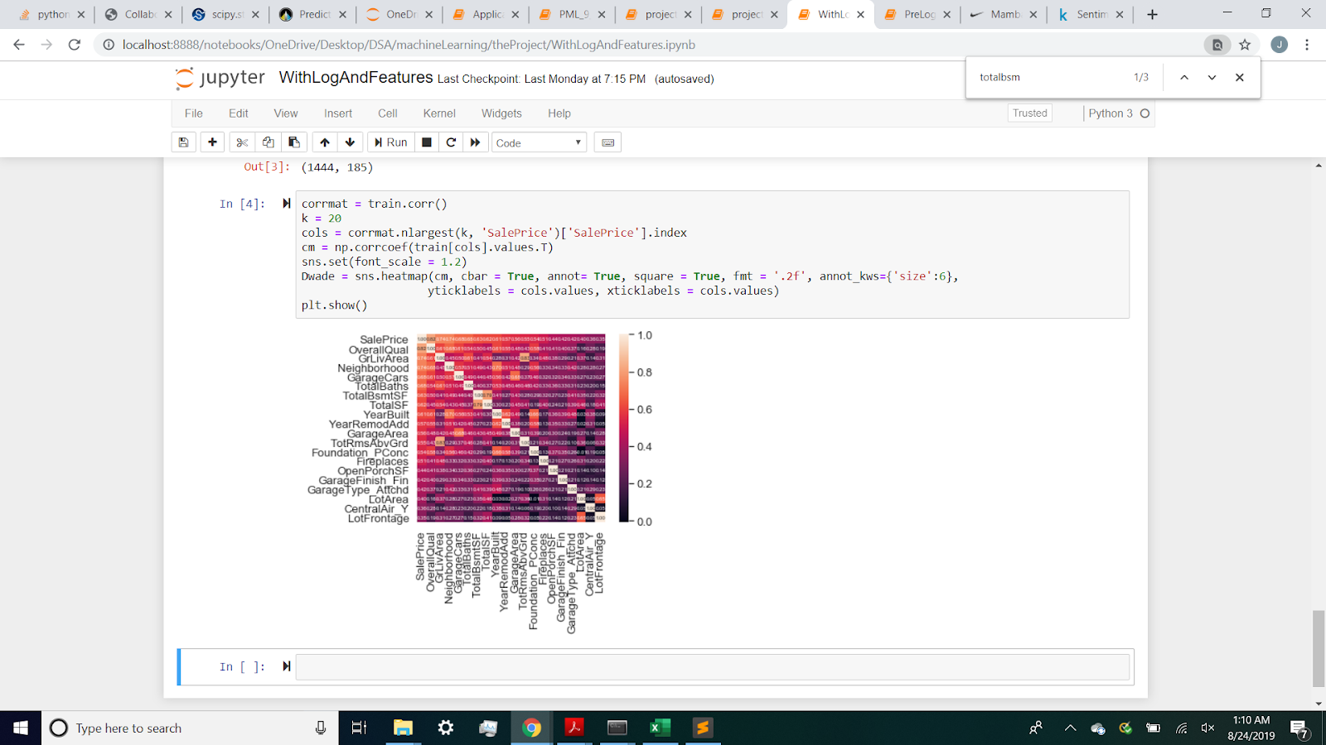
Top 20 Correlation After New Features

Slide 5
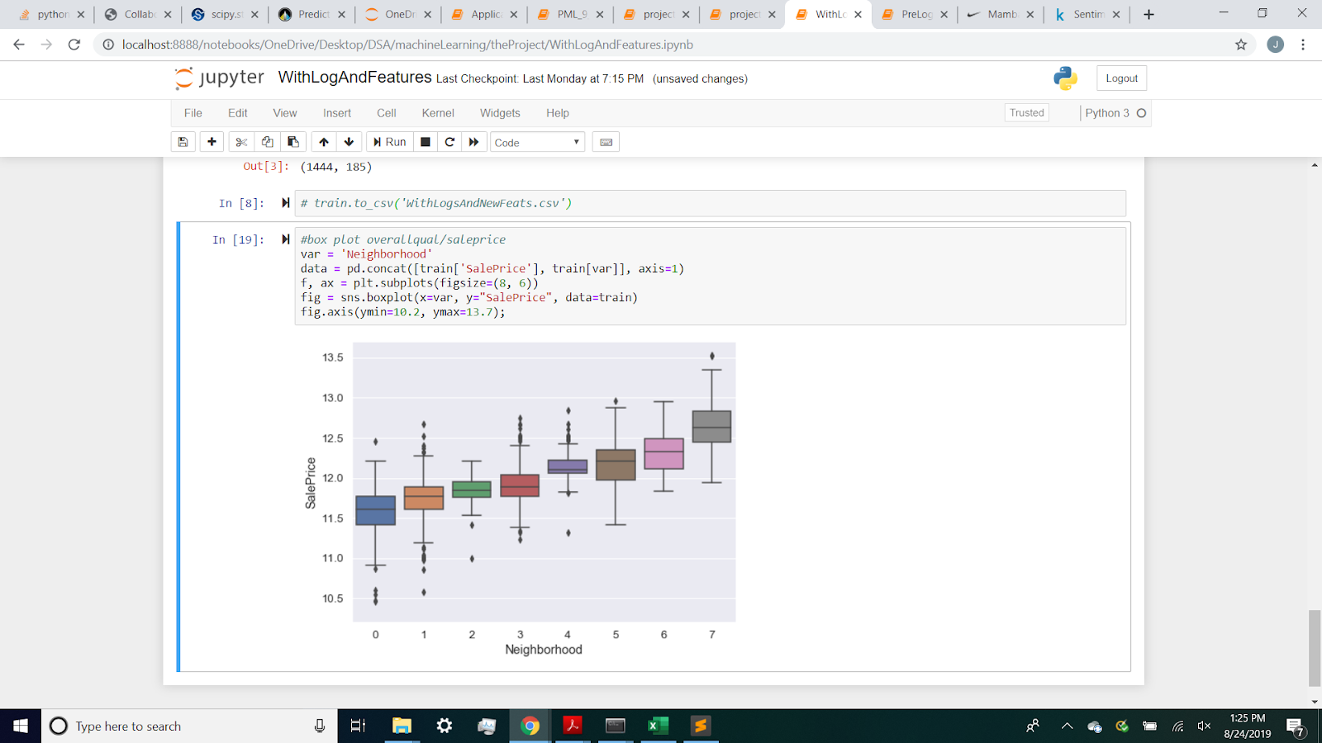
Sale Price and Neighborhood Box Plot

Slide 6
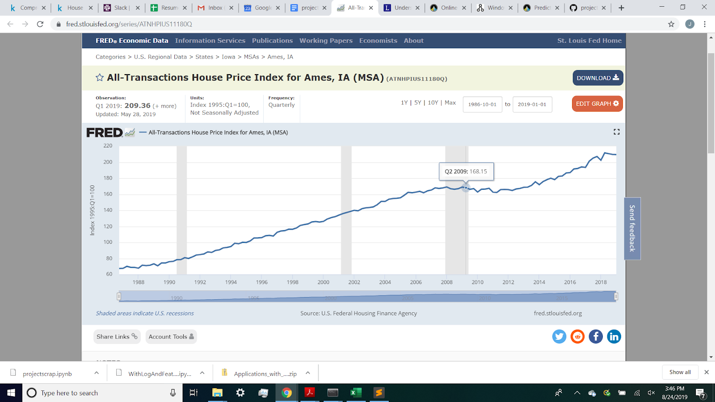
House Price Index Transactions

Slide 7
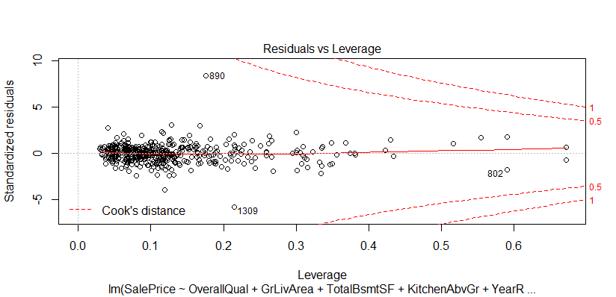
AIC Residuals vs Leverage

Slide 8
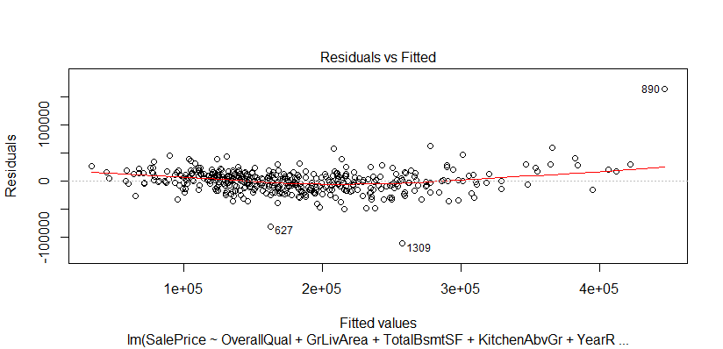
AIC Residuals vs Fitted

Slide 9
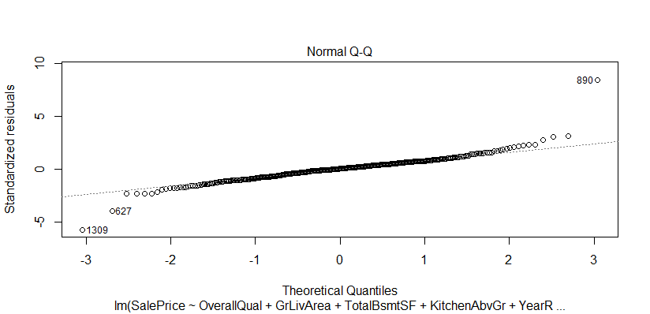
AIC Q-Q Plot

